Slide 1
Application software
Slides by:Miss Bushra
Lecturer of Iqra Girls college sgd
Slides for:Msc(IT)

Slide 2
Application Software
Application software consists of programs
designed to make users more productive and/or
assist them with personal tasks.
Application software has a variety of uses:
1. To make business activities more efficient
2. To assist with graphics and multimedia projects
3. To support home, personal, and educational
tasks
4. To facilitate communications

Slide 3
Application Software
Application software is available in a variety of
forms:
packaged
custom
Web application
Open source
shareware
freeware
public domain.

Slide 4
Packaged software is mass-produced,
copyrighted retail software that meets the needs
of a wide variety of users, not just a single user
or company. Packaged software is available in
retail stores or on the Web.
Custom software performs functions specific
to a business or industry. Sometimes a company
cannot find packaged software that meets its
unique requirements.

Slide 5
A Web application is a Web site that allows
users to access and interact with software from
any computer or device that is connected to
the Internet. Many Web sites provide free
access to their programs; some charge a fee.
Open source software is software provided
for use, modification, and redistribution.
This software has no restrictions from the
copyright holder regarding modification of
the software’s internal instructions and its
redistribution.

Slide 6
Shareware is copyrighted software that is
distributed at no cost for a trial period. To
use a shareware program beyond that period,
you send payment to the program developer.
Freeware is copyrighted software provided
at no cost by an individual or a company
that retains all rights to the software.

Slide 7
Public-domain software has been donated
for public use and has no copyright restrictions.
Anyone can copy or distribute public-domain
software to others at no cost.

Slide 8
Business Software
Business software is application software
that assists people in becoming more effective
and efficient while performing their daily
business activities. Business software includes
programs such as word processing, spreadsheet,
database, presentation, note taking, personal
information manager, business software for
phones, business software suites, project management,
accounting, document management,
and enterprise computing software.

Slide 9
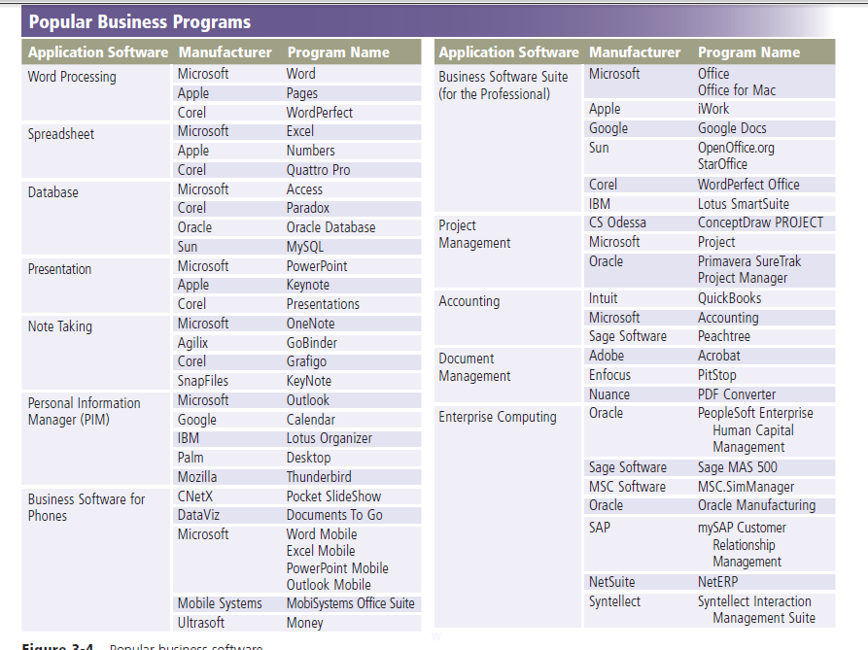
Business Software

Slide 10
Word Processing Software
Word processing software, sometimes called a word processor, allows users to create and manipulate documents containing mostly text and sometimes Graphics
Millions of people use word processing software
every day to develop documents such as letters,
memos, reports, mailing labels, newsletters, and
Web pages.

Slide 11
Spreadsheet Software
Spreadsheet software allows users to
organize data in rows and columns and perform
calculations on the data. These rows and columns
collectively are called a worksheet.
Because of spreadsheet software’s
logical approach to organizing data, many people
use this software to organize and present
nonfinancial data, as well as financial data.

Slide 12
Database Software
A database is a collection of data organized
in a manner that allows access, retrieval, and
use of that data. In a manual database, you
might record data on paper and store it in a
filing cabinet.
Database software is application software
that allows users to create, access, and manage
a database. Using database software, you
can add, change, and delete data in a database;
sort and retrieve data from the database;
and create forms and reports using the data in
the database.

Slide 13
Presentation Software
Presentation software is application software
that allows users to create visual aids for
Presentations to communicate ideas, messages,
and other information to a group.
The presentations can be viewed as slides,
sometimes called a slide show, that are displayed
on a large monitor or on a projection screen.

Slide 14
Note Taking Software
Note taking software is application software
that enables users to enter typed text, handwritten
comments, drawings, or sketches anywhere
on a page and then save the page as part
of a notebook
Users find note taking software convenient
during meetings, class lectures, conferences,
in libraries, and other settings that previously
required a pencil and tablet of paper for
recording thoughts and discussions.

Slide 15
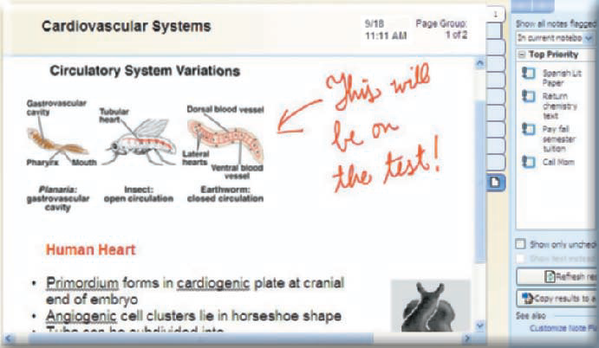
Note Taking Software

Slide 16
Business Software Suite
A software suite is a collection of individual
programs available together as a unit.
Popular business software suites include Microsoft Office, Apple iWork, Corel WordPerfect Office, and Google Docs.
Software suites offer two major advantages:
lower cost and ease of use.

Slide 17
Calender and contact management
Calender and contact management software is an app that helps you to organize your calender,keep track of contact and share this information with others,who can view it on their computer and mobile devices.

Slide 18
Personal Information
Manager Software
A personal information manager (PIM) is
application software that includes an appointment
calendar, address book, notepad, and other
features to help users organize personal
information.
Mobile devices such as smart phones and
PDAs include, among many other features,
PIM functionality.

Slide 19
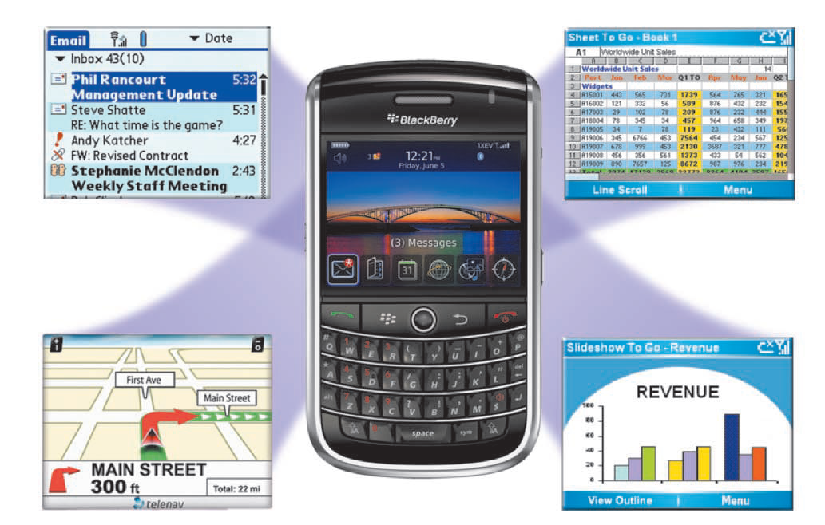
Personal Information
Manager Software

Slide 20
Business Software for Phones
In addition to PIM software, a huge variety
of business and other software is available for
Phones Some software is preloaded
on the phone, while other programs can
be downloaded or accessed on memory cards
that you insert in a slot on the device.

Slide 21
Project Management
Software
Project management software allows a user to
plan, schedule, track, and analyze the events,
resources, and costs of a project.
Project management software helps users
manage project variables, allowing them to
complete a project on time and within budget.

Slide 22
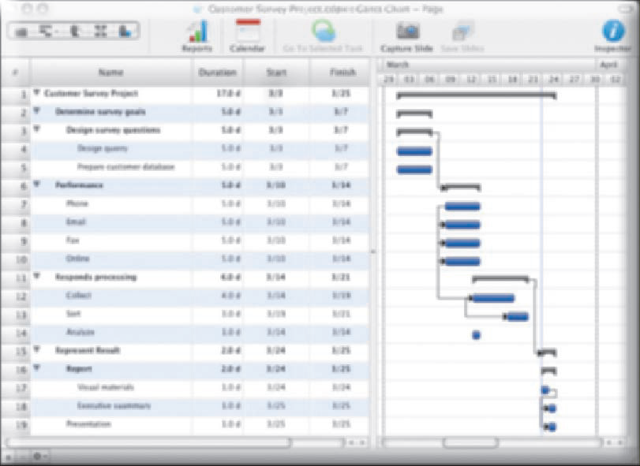
Project Management
Software

Slide 23
Accounting Software
Accounting software helps companies
record and report their financial transactions
With accounting software, business users perform
accounting activities related to the general ledger,
accounts receivable, accounts payable, purchasing,
invoicing, and payroll functions.
Accounting Software also enables business users
to write and Print checks, track checking account
activity, and update and reconcile balances on
demand.

Slide 24
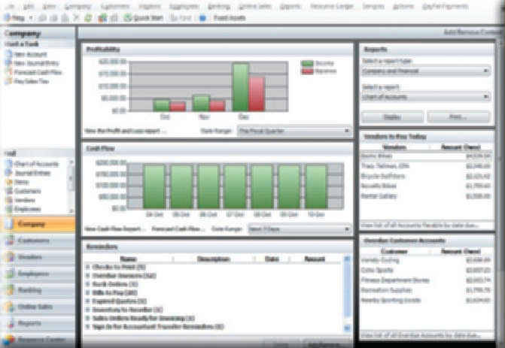
Accounting Software

Slide 25
Document Management Software
Document management software provides
a means for sharing, distributing, and searching
through documents by converting them
into a format that can be viewed by any user.
A popular file format that document management
software uses to save converted documents
is PDF (Portable Document Format),
developed by Adobe Systems.

Slide 26
Enterprise Computing Software
A large organization, commonly referred to
as an enterprise, requires special computing
solutions because of its size and large geographic
distribution.
A typical enterprise consists of a wide variety of
departments, centers, and divisions collectively
known as functional units.

Slide 27
Graphics and Multimedia
Software
This software includes computer aided
design, desktop publishing, paint/image
editing, photo editing, video and audio editing,
multimedia authoring, and Web page authoring.
Power users such as engineers, architects,
desktop publishers, and graphic artists often use
sophisticated software that allows them to work
with graphics and multimedia.

Slide 28
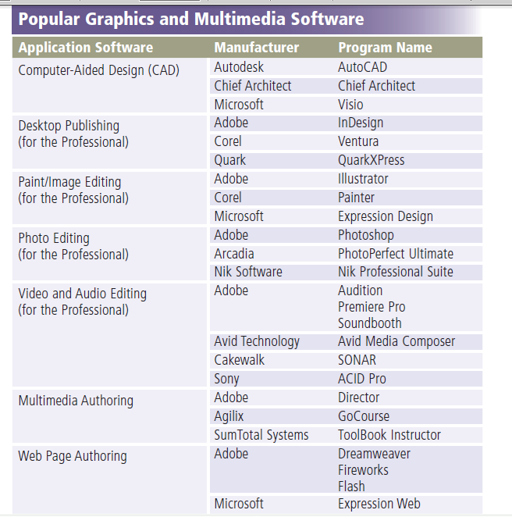
Graphics and Multimedia
Software

Slide 29
Computer-aided design (CAD) software
is a sophisticated type of application software
that assists a professional user in creating engineering,
architectural, and scientific designs.
Desktop publishing (DTP) software
enables professional designers to create sophisticated
documents that contain text, graphics, and many colors.
Professional DTP software is ideal for the production of
high-quality color documents such as textbooks,
corporate newsletters, marketing literature, product
catalogs, and annual reports.

Slide 30
Paint software, also called illustration software,
allows users to draw pictures shapes, and other
graphical images with various on-screen tools such
as a pen, brush, eyedropper, and paint bucket.
Image editing software provides the capabilities
of paint software and also includes the capability to
enhance and modify existing images and pictures.

Slide 31
Multimedia & web authoring
It allows you users to combine text,graphic,audio,video and animation in an application,also help user of all skill level create related webpages that include all media along with interactive and blog posts.

Slide 32
Others media software
Media playesr
Disc burning
Video and audio editing

