Slide 1
DATA WAREHOUSE ARCHITECHTURE
Architechture is a conceptualization of how the data warehouse is built.
One possible simple conceptualization of a data warehouse architecture consists of the following interconnected layers:
Operational database layer: The source data for the data warehouse - An organization's ERP systems fall into this layer.
Informational access layer: The data accessed for reporting and analyzing and the tools for reporting and analyzing data - Business intelligence tools fall into this layer. And the Inmon-Kimball differences about design methodology, discussed later in this article, have to do with this layer.

Slide 2
Data access layer: The interface between the operational and informational access layer - Tools to extract, transform, load data into the warehouse fall into this layer.
Metadata layer: The data directory - This is often usually more detailed than an operational system data directory. There are dictionaries for the entire warehouse and sometimes dictionaries for the data that can be accessed by a particular reporting and analysis tool.

Slide 3
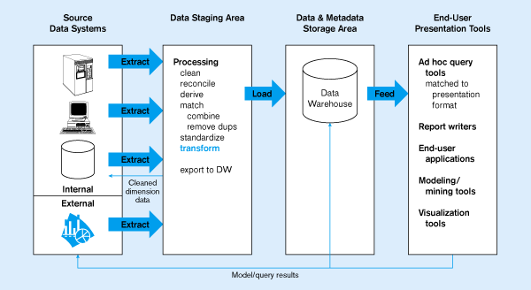
Figure 11-2: Generic two-level architecture
L
One, company-wide warehouse
T
E
Periodic extraction ➔ data is not completely current in warehouse
<number>

Slide 4
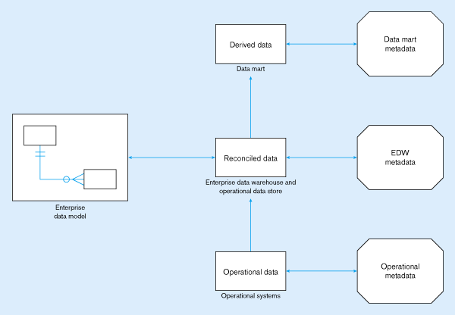
Figure 11-6: Three-layer architecture
<number>

Slide 5
DATA WAREHOUSING ARCHITECHURE
Monitoring & Administration
OLAP servers
Metadata Repository
Analysis
Query/ Reporting
Data Mining
DATA
WAREHOUSE
Extract
Transform
Load
Refresh
External Sources
Serve
Operational databases

Slide 6
BENEFITS
A data warehouse provides a common data model for all data of interest regardless of the data's source.
Prior to loading data into the data warehouse, inconsistencies are identified and resolved. This greatly simplifies reporting and analysis.
Information in the data warehouse is under the control of data warehouse users so that, even if the source system data is cleared over time, the information in the warehouse can be stored safely for extended periods of time.

Slide 7
Because they are separate from operational systems, data warehouses provide retrieval of data without slowing down operational systems.
Data warehouses facilitate decision support system applications such as trend reports, exception reports, and reports that show actual performance versus goals.
Data warehouses can work in conjunction with and, hence, enhance the value of operational business applications, notably customer relationship management (CRM) systems.

