Slide 1
Digital Computer & Digital Systems
Digital age has a prominent role in every day life.

Slide 2
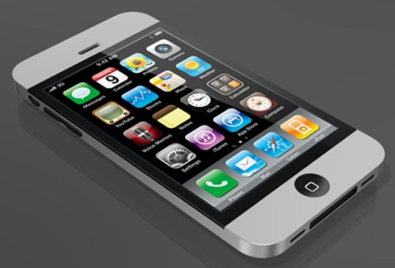
Motivation
Analysis & design of digital electronic circuits
Why digital circuits?
  They are everywhere and generic
  digital computers, smart phones, data communication, digital recording, digital TV, many others
Fundamental concepts in the design of digital systems
Basic tools for the design of digital circuits
Logic gates (AND, OR, NOT)
  Boolean algebra

Slide 3
What Is a Computer?
A computer is an electronic device, operating under the control of instructions stored in its own memory
Collects data
(input)
Processing
Produces information (output)
Information Processing Cycle

Slide 4
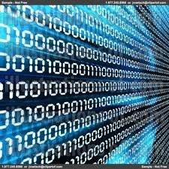
DIGITAL COMPUTER:
Consists of electronic components and electromechanical devices.
These components can maintain only two discrete states (i.e high voltage/low voltage or ON/OFF).
The word digital implies that the information in the computer is represented by variables that take a finite number of discrete values (0 or 1).
By using various coding techniques (groups of bits) can be made to represent not only binary numbers but also other decimal digits, letters, or meaningful symbols
Digital computer’s functions are:
  General Purpose machine
  more reliable and accurate results.
  Count Quantities rather than measuring
  Input / Output in digits as well as in graphical form.

Slide 5
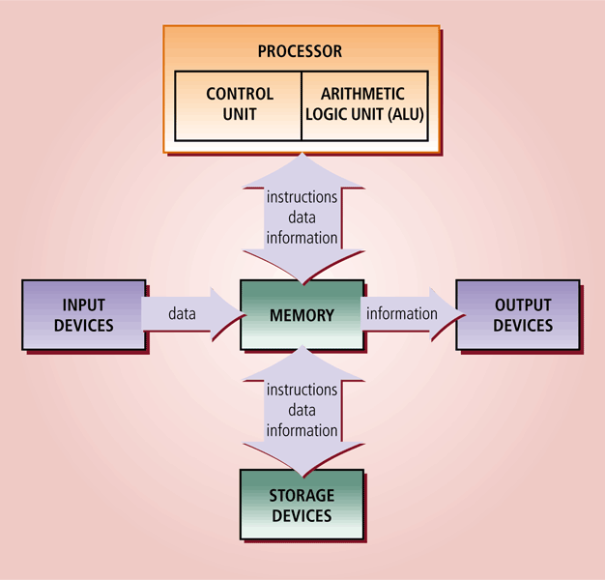
Block Diagram of Digital Computer

Slide 6
DIGITAL SYSTEM
Implementation of digital computer is known as digital system.
Digital Computers have been made possible many scientific, industrial, and commercial advances that would have been unattainable otherwise.
Our space program would have been impossible without real-time, continuous computer monitoring.
Business enterprises function efficiently only with the aid of automatic data processing.
Air traffic control, space guidance, the educational field and many other areas also uses digital systems.
Other examples include telephone switching exchanges, digital voltmeters, digital counters, electronic calculators, and digital displays.
From these applications, the appropriate name for a digital computer would be a “Discrete Information Processing System”.
Digital computer is the interconnection of digital modules.

Slide 7
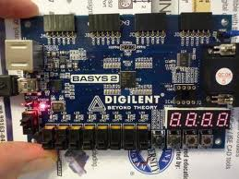
Your Board

Slide 8
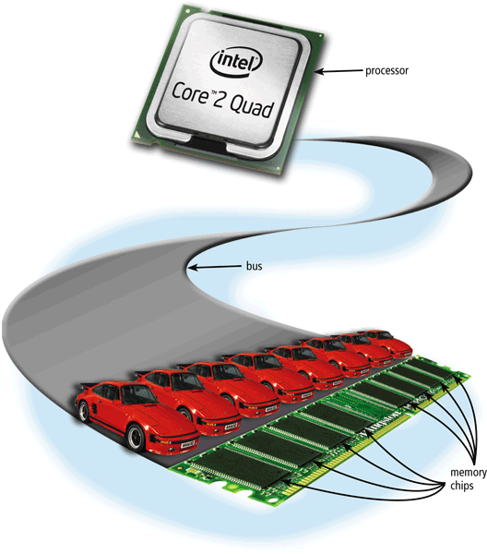
Buses
A bus allows the various devices both inside and attached to the system unit to communicate with each other
  Data bus
  Address bus
  Control bus
A computer can have these basic types of buses:
  System bus
  Expansion bus

Slide 9
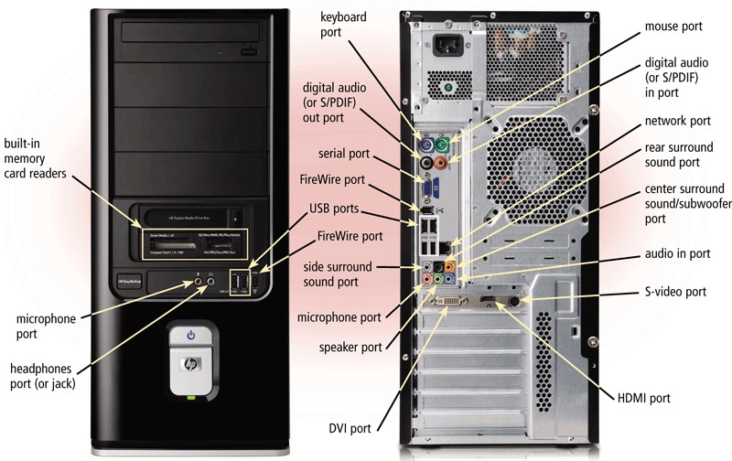
Ports and Connectors

