Slide 2
Chapter: 10
Wired and Wireless Network and Devices

Slide 3
Communication
The process in which two or more computers or devices transfer data, instruction and information is known as communication.

Slide 4
Needs for communication
Sending device
Transmission media
Reciving device

Slide 5
Networks
A network is a collection of computersvand devices connected together via communication devices and transmission media.

Slide 6
Benefits
Facilitate communications
Share hardware
Share data and information
Share software
Transfer funds

Slide 7
Intranet
An intranet is an internal network that uses internet technologies.interanet generally make company information accessible to employees and facilitate collaboration within an organization.

Slide 8
Extranet
Extranet means outside or beyond,which allows customers or suppliers to access its interanet.package shipping companies, for example allow customers to access their interanet through to print air bill.

Slide 9
Network standards and protocols

Slide 10
Network standards
A network standard decide guidelines that specify the way computer access the medium to which they are connected, the type of medium used,the speed used on different types of networks.
Hardware are design to meet these standards.
An example of standard is ethernet

Slide 11
Standards are the documents that contain technical and physical specification about network being designed.

Slide 12
Organizations to define network standard
American National standard institute(ANSI)
Institue of Electrical and electronic Engineers(IEEE)
International standard organization(ISO)

Slide 13
Protocols
The working set of rules and specifications that are used to make something happen.
An example of protocol would be TCP/IP,DHCP,ICMP,GTP,DIAMETER,RADIUS etc.
The specifics of the above would detail the addressing format, number of bits used, methods to decide grouping, size of data chunks and more

Slide 14
Ethernet
Ethernet is a network standard. used in (LAN), (MAN) and (WAN).^{[1]} It was commercially introduced in 1980 and first standardized in 1983 as IEEE 802.3
Defines guidelines for the physical configuration of a network.
Inexpensive and easy to install and maintain.
Transfer rate 10Mbps to 100 Gbps

Slide 15
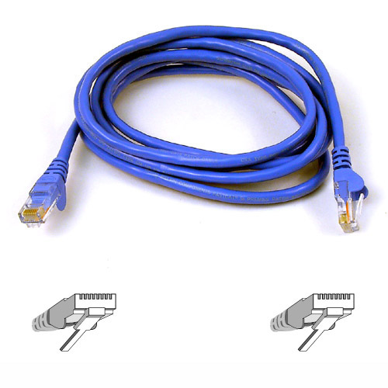

Slide 16
Token ring
LAN standard.
Share or pass token in unidirectional manner.
Single token exist in a network.
Often connect 72 devices.
With amendmend 260 are to be attached.
Transfer rate:4Mbps to 1Gbps.

Slide 17
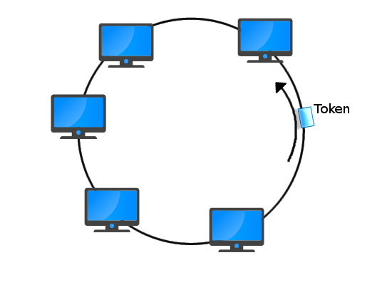

Slide 18
UWB
Ultra wide band is a network standard that specify how two devices use short range and high band width(500Mhz) radio wave to communicate at high speed with each other.
Speed 110 Mbps at distance of 33 feet
480 Mbps at distance of 6.5 feet.
Best for sending large files like audio video speedily.

Slide 19
UWB
Have pentrating power even to pass through obstacles.
Its precision capabilities and low power make it applicable in real time location system.
Also used in “see through the wall”” precision radar imaging technology.
UWB radar has been proposed as the active sensor component in automatic target recognition appliccation design to detect humans or objects fallen o subway track.

Slide 20
Radar
RAdio Detection And Ranging[
Radar is an object-detection system that uses radio waves to determine the range, angle, or velocity of objects. It can be used to detect aircraft, ships, spacecraft, guided missiles, motor vehicles, weather formations.

Slide 21
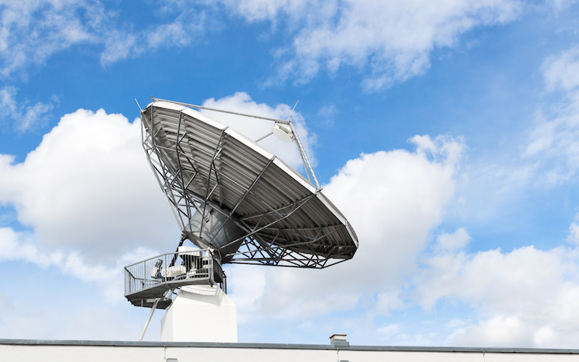

Slide 22
IrDA
Infrared data association standard to transmit data wirelessly to each other through infrared light waves.
Speed tranfer rate is 115Kbps between their irDA ports.
Required line of sight transmisssion.
Coverage about one meter
Used in moblie phone laptop etc.

Slide 23
LTE
Long term Evaluation
It is a network standard that define how high speed cellular transmission(mobile transmission) use broadcast radio to transmit data for mobile communications.
Down stream LTE has the rate of 100Mbps .
Upstream LTE has the rate of 30Mbps.
Based on TCP/IP.

Slide 24
LTE
LTE support data,messaging,voice and video transmission.

Slide 25
WIFI
Wireless fidelity .it identify any network based on the 802.11 sandard.
802.11 is a series of network that specify how two wireless devices communicate over the air with each other.
Transfer rate: 11Mbps to 7Gbps
Wifi ethernet(wireless ethernet):uses technique similar to the ethernet standard

Slide 26
TCP/IP
Transmission control protocol/internet protocol.
It is a network protocol that defines how message are routed from one end of a network to the other,ensuring the data arrive correctly.
Packet: message is divided into small pieces called packets.
Packet switching :breaking message into packets,sending and then reassembling.

Slide 27
Bluetooth
Bluetooth is a network protocol that define how two bluetooth devices use short range radio wave to transmit data.contain small chip that allows it to communicate with other bluetooth devices.
Speed 3Mbps
Coverage: work within 33 feet but extended to 325 feeet with amenmends.

Slide 28
RFID
Radio frequency identification is a protocol that defines how a network uses radio signals to communicate with a tag placed in or attached to an object ,an animal ,or person.
Tag consist of antenna,an RFID reader , also called transciever read radio signals and transfer information to a computer or computing devices.
Coverage: 3000 feet or more.

Slide 29
NFC
NFC near field communication is a protocol based on RFID that defines how a network uses close range radio signals to communicate between two devices.
Smart phone digital camera .

Slide 30
FTP
The File Transfer Protocol (FTP) is used to transfer files over the internet.Audio,video graphics and data files can be uploaded or downloaded using this protocol.
Introduced on April 1971.

Slide 31
MIME
t was proposed by Bell Communications in 1991.
MIME (Multi-Purpose Internet Mail Extensions) is a protocl that lets people use to exchange different kinds of data files on the Internet: audio, video, images, application programs.

Slide 32
Types of Network
LAN
WAN
MAN
PAN
Differencce is only of coverage between all of these.

Slide 33
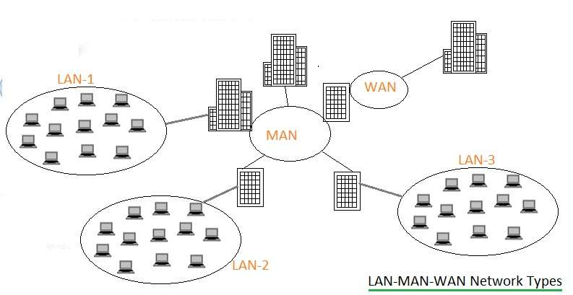

Slide 34
Local area network
Limited connectivity
Closely positioned buildings
Single computer act as node.
High speed send at the rate of 10mbps to 1000Mbps.
Secure network.
Easy configuration.
Easy modification.

Slide 35
Technology in LAn
Locally installed, twisted pair, fiber optic cable, wireless

Slide 36
MAN
Connect LANs in a metropolitan area.
Maintenance is difficult.
High speed, typically 100 Mbps
Expensive than LAN.
Higher data speed than LAN.
Example: branches of a company in the city.

Slide 37
WAN
Coverage Unlimited (usually in 1000Km) range, uses repeater and other connectivity for range extension .
Variety of wire and wireless transmision media.
Slow speed, about 1.5 Mbps (May vary based on wireless technologies used)
Internet is a WAN.
Transmission speed is 56kbps to 50kbps.
Expensive than Lan.
Example ATM
NADRA

Slide 38
Major technologies used in MAN
Locally installed and based on common carrier e.g. twisted pair wires, fiber, coaxial cable, wireless including wireless and cellular network based

Slide 39
PAN
It is a network that connects computers and devices in an individual’s workspace using wired and wireless technologies.

Slide 40
Network architcture
The configuration of computers,devices and media on a network is called network architecture
Client server
Peer to peer

Slide 41
Client Server
Server known as host. Server have the control to hardware,software and to all other resources
Clients are computer that rely on the server for its resources.
One or more Computer act as a server and other computer on network request services from server.

Slide 42
Peer to peer
In this architcture Each computer has equal rights and responsbilities.they have equal capabilities ,sharing hardware,data.
They have no common file server.
This can be setup between an andriod tablet and windows laptop

Slide 43
Communication lines

Slide 44
Communication lines
The lines that establish that connect the devices and enable transmission between them.
Dedicated lines:They establish communication between two communication devices.
May be analog or digital.
Comonly used are digital lines.

Slide 45
Cable
Cable television provide this .
It uses coaxial cable to make connection with modem and this further use ethernet to connect with system.
Transfer rate:256kbps to 52Mbps
Faster then DSL and cheaper then fiber optic
Not secure.

Slide 46
DSL
Digital subscriber line
Uses copper wires.
Rate:256kbps to 8Mbps.
Type ADSL(asymmetric digital subscriber line)
Downstrream is higher then downstream in ADSL.
SDSL(symmetric digital subscriber line) capacity to carry in both directions
Secure.
Provided by telephone

Slide 47
Capable of delivring high speed data access to users within 18000 feet of the telephone company central office.
Dedicated DSL require router otherwise only adopter is needed.
Cost is not based on usage
Require modem and power supply too.
it requires a good quality phone line, a local exchange to be “enabled” and you need to be located within a certain distance from the exchange. This makes it quite limited and is not really an effective solution for much of rural Ireland.

Slide 48
ISDN
Integrated service digital network
Carry 2 or 3 signals at a time(multiplexing)
Uses copper lines
Transfer rate:1.54Mbps.
Allow Voice and data transmission
Line conditioning and load coils placed at every 1000 feet in series to reduce noise
BRI(basic rate interface) for home users

Slide 49
Dial up
Always on Direct ISDN

Slide 50
FTTP
Fiber to the premises
Uses fiber optic cable.
High speed 5Mbps to 300Mbps
FTTH(fiber to the home) provided to home users
FTTB(fiber to the building) bussiness users optical terminal which recive signal.

Slide 51
T carrier
Long distance digital phone lines that carry multiple lines over single lines.
Fast data transfer rate.
Expensive
Fractional T1 line used by bussines people in which they share connection.
Rate of fractional T1:128Kbps to 768Kbps
Slower then dedicated T1
T3 lines equal to 28T1.used by large corporation like ISP who want to connect with backbone.

Slide 52
Rate of T3:44.736Mbps

Slide 53
ATM
Asynchronous transfer mode
It’s a service that carries voice,data video,media etc at high speed.
Phone network and other network with large amount of trafic uses .
155Mbps to 622Mbps.

Slide 54
Communication devices
Hardware capable of transmitting data,instructions and information between sending and reciving device.
Data sent from sending device to medium.
On reciving side reciving device recive signals from medium.

Slide 55
modem
Short for MODulator/DEModulator, the first Modem known as the Dataphone was first released by AT&T in 1960. It later became more common for home users when Dennis Hayes and Dale Heatherington released the 80-103A Modem in 1977.

Slide 56
A Modem or Broadband Modem is a hardware device that connects a computer or router to a broadband network. For example, a Cable Modem and DSL Modem are two examples of these types of Modems.
A Dial-up Modem is a hardware device that allows a computer to send and receive information over telephone lines by converting digital data into an analog signal used on phone lines.

Slide 57
Rate of modem :300bps to 56k bps

Slide 58
Types of broadband modem
DSL modem
Cable modem
ISDN modem

Slide 59
DSL modem:Broadband modem that send digital data from computer to DSL line and recive digital data and information from a DSL line
Cable modem:broadband modem that send and recive digital data via CATV network.required a splitter where one line for tv and other for internet modem

Slide 60
Wireless modem
A wireless modem is a modem that bypasses the telephone system and connects directly to a wireless network, through which it can directly access the Internet connectivity provided by an Internet service provider (ISP).
Available as prebuilt and may be extrnally intalled
Mobile hotspot function as wireless modem

Slide 61
Wireless access point
It’s a communication device that allow to transfer data wirelessly among them and also to a wired network using wireless technology such as wifi.
Have high speed internal or external antennas for manipulating signals.
Suggestion for good speed is to place on highest position .

Slide 62
Router
A router is a networking device that connect multiple computer or othr router together.
Useful in any size of network.
Wireless router:it perform function of a router and also as a wireless access point .
Broadband router: perform function of a router and also as a broadband modem.
Broadband wireless router: perform functionality of a router ,WAP and a cable or DSL modem.
Mobile broadband wireless router:perform function of a router,WAP and a wireless modem.Example we use mobile broadband wireless router to create a mobile hotspot.

Slide 63
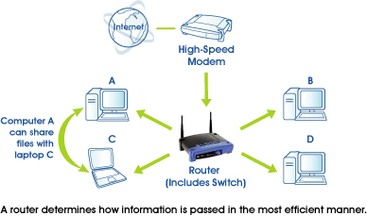

Slide 64
NIC

Slide 65
NIC
Network interface card is a communication device that enable a computer that does not have built in networking capability to access a network.
Available in different forms such as adopter card,usb adopter

Slide 66
Hub and switch
Hub or switch is a dvice that provide central point for cables in a network.larger network uses a hub while

